Slide 1
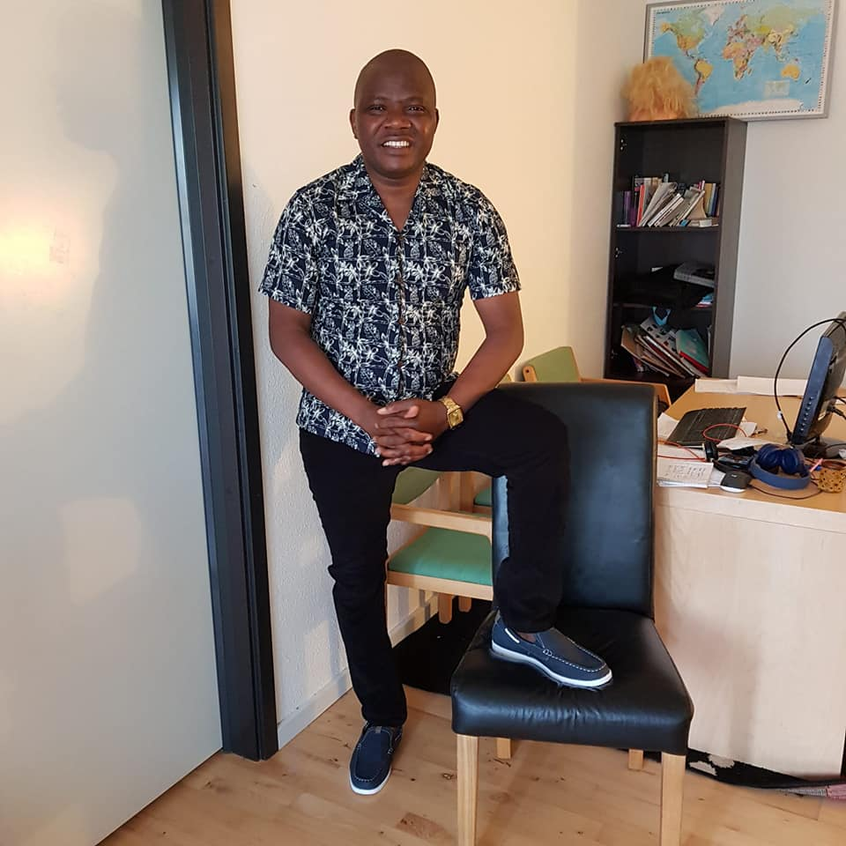
THE EXTRAORDINARY YEAR IN ONE PAGE
  Teaching and supervision
    9 First year computer science semester projects
    1 SPA 7th semester project & 1 SPC long masters thesis
    Co-host: 2 PhD students from University of Malaga, Spain
    Teaching: Algorithms [COMTEK 3] and ASSP [SPC 9 & MATTEK 7]
    Nomination for ‘’Teacher of the Year Award’’
    Departmental approval for the “Adjunkt pedagogikum” course
    Over 500 teaching hours
  Research
    Engagements:
      6G in-X subnetworks [Gilberto, Preben,..]
      ML for radio channel calibration [Troels P. and Ayush Bharti]
      AI for 6G Air-interface design [Carles, Gilberto, Sajad + others from Nokia]
    Output and impacts:
      Contribution to 7 publications [3 journals, 3 conferences & 1 magazine]
      Highest annual citation increase
  Others
    Finally enrolled in Danish classes after 3+ years in Denmark
    We survived and are surviving the lock-down

